Slide 1
Routing for Driving Pleasure
Aka “What's the most fun way to get some where?”
Dan “Ducky” Little
@theduckylittle
dan.little@dbspatial.com
http://github.com/theduckylittle/routing-for-fun

Slide 2
What do we do now?
We route for speed!
The idea seems to be to get people off the road as quickly as possible.
Maximum speed with minimal distance.

Slide 3
Why is that so boring?
Have you ever seen the look of an interstate?

Slide 4
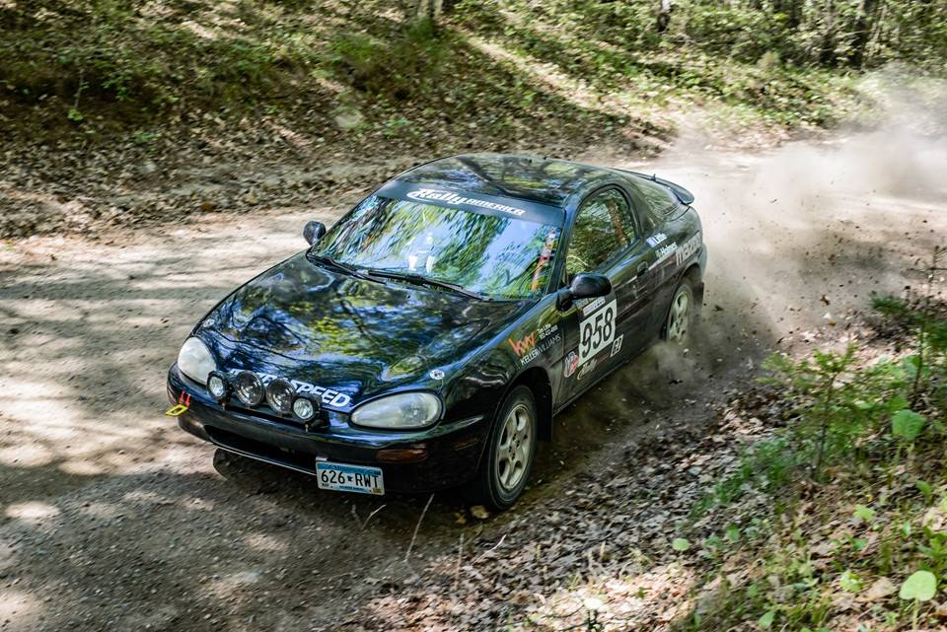
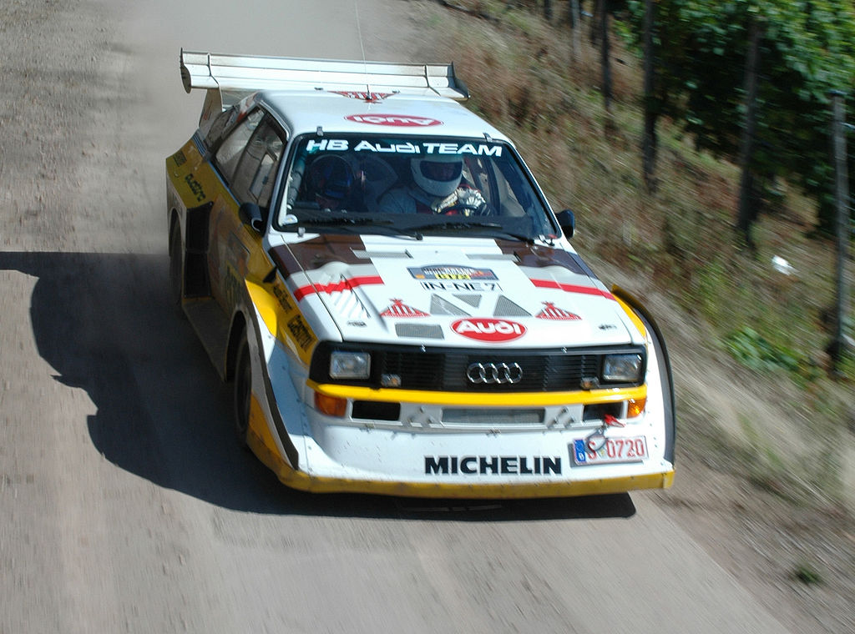
What is a “rally”?
There are two kinds of rally
“Special Stage”, “Stage”, “Pro”, or “Performance” Rallies are speed competitions run off road.

Slide 5
The Other Kind of Rally
“Tour” Rallies or “Time-Speed Distance” Rally
The goal is to arrive at a specific place on a specific time.
“Casual” timing is to the second.
Highly competitive rallies are measured to the hundredth of a minute. That's 0.6 of a second.

Slide 6
That doesn't sound so hard
Please, come try it!

Slide 7
What about GIS?
Right, back to GIS.
Planning a rally can be hard.
The goal is to find 'fun' roads to drive.

Slide 8


What makes a road fun?
Turns! “Twistys”
Speed!
Turns with Speed!
Gravel!*
Long Straight Roads
Traffic
People complaining when you drive past.
* This is subjective, I'm biased, and this is disclosure.

Slide 9
Time for Math!
Tortuosity is a relative measure of curvy-ness.
It is the ratio of the length of the curve over the distance between the starting and end point.

Slide 10
For Example...
A Straight Line...
(0,0)
(1,0)
Length of the Line:
A^2 + B^2 = L^2
1^1 + 0^2 = L^2
Sqrt(1 + 0) = L
1 = L
Distance between Starting Points
A^2 + B^2 = C^2
1^1 + 0^2 = C^2
Sqrt(1 + 0) = C
1 = C
Tortousity
T = L / C
T = 1.0

Slide 11
A Curvier Example
This is a half-circle.
(0,0)
(1,0)
Length of the Line:
P = Pi * R
P = Pi * .5
P = 3.14159 * 1
P = 3.14159
Half of the circle..
L = P * .5
L = 1.57
Distance between Starting Points
A^2 + B^2 = C^2
1^1 + 0^2 = C^2
Sqrt(1 + 0) = C
1 = C
Tortousity
T = L / C
T = 1.57

Slide 12
How do we find these roads?
OpenStreetMap Data for Minnesota
Postgresql with PostGIS and pgRouting Installed

Slide 13
Loading up the Data
Don't use the wrong tools!
No seriously...
Osm2pgrouting
This works well if you have a lot of the setup done ahead of time.
Osm2po
Has some license/open-ness issues but WORKS

Slide 14
Loading up the data...
java -Xmx1g -jar osm2po-core-5.1.0-signed.jar prefix=hh tileSize=x ../minnesota-latest.osm.pbf postp.0.class=de.cm.osm2po.plugins.postp.PgRoutingWriter

Slide 15

Loading up the data...
./osm2po_minnesota.sh

Slide 16
Calculating Tortuosity
With all the data loaded we can finally do math!

Slide 17
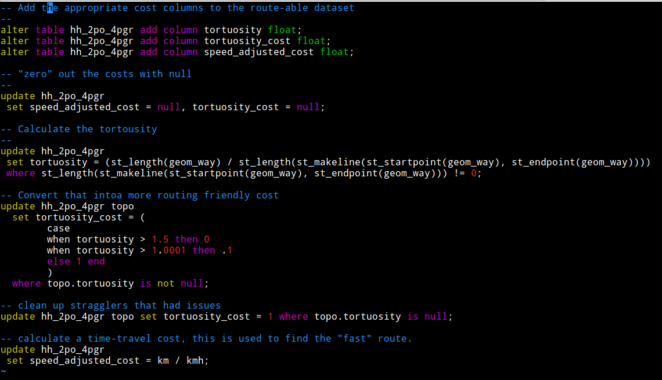
All you need to do is this...

Slide 18
Or this...

Slide 19
And finally make a topology
Topologies are a network of “nodes” and “links” that form a “graph”. This collection of nodes and links can be used to find a path.
create_topology.sql

Slide 20

And this all builds to!!!
A programmer using a Desktop GIS Package.

Slide 21
Routing Between Places
Given two different points… find a route.
The SQL gets pretty complicated. I have written a python script that does the dirty work…
There is also a script “create_example_routes.sh” that created the next examples
./create_route.py -- “dbname=gis user=gis password=gis15fun host=localhost” -92.07286,46.816695 -91.865675,47.903252 duluth_to_ely

Slide 22
Classic Saturday Drive Problem
Start with Coffee.
End with Beer.
Coffee.
Beer.
Fun?

Slide 23
Back to QGIS!

Slide 24

Results
If you want to tackle a similar problem you'll find yourself facing the same obstacles.
I hope this can save you time and effort.
Try Rallying!
  https://www.facebook.com/TwinCityRallyClub/
  https://www.facebook.com/groups/Rallye1/
Enjoy the source!
  https://github.com/theduckylittle/routing-for-fun

